Slide 1
A USERS Guide to COVID imaging
Brian Locke,, MD. Chief medical Resident
Notes:
This is on the CLINICAL USE of imaging – I’m not qualified to actually talk about the nuances of interpretation themselves… only how you should use the imaging.
Even if they give you the report, it comes down to how to interpret it and integrate with decision making. => A little deeper dive in towhen imaging can help in the diagnosis.
Goal of practice: to synthesize knowledge around what the findings actually mean, especially for CT and US. CXR – just need to know this.

Slide 2
Learning goals
Understand when imaging is useful in COVID
Know what to look for in a CXR
Know what to look for in a CT
Understand why radiologists need the clinical history
@UtahIMCMRs
Notes:
And know at least 1 reason why Brian hates iCentra.

Slide 3
Imaging for Screening?
@UtahIMCMRS
Notes:
Note: clinically correlate = pre-test probability
As you’ll hear, “we don’t know the sensitivity” is the common answer to how good this test is… unfortunately, we need to make decisions now – so we’re still using the test even without knowing. Here’s ‘going beyond that we don’t’ know the sensitivity’
Unfortunately, I’m not going to give an algorithm, because it’s going to be wrong.

Slide 4
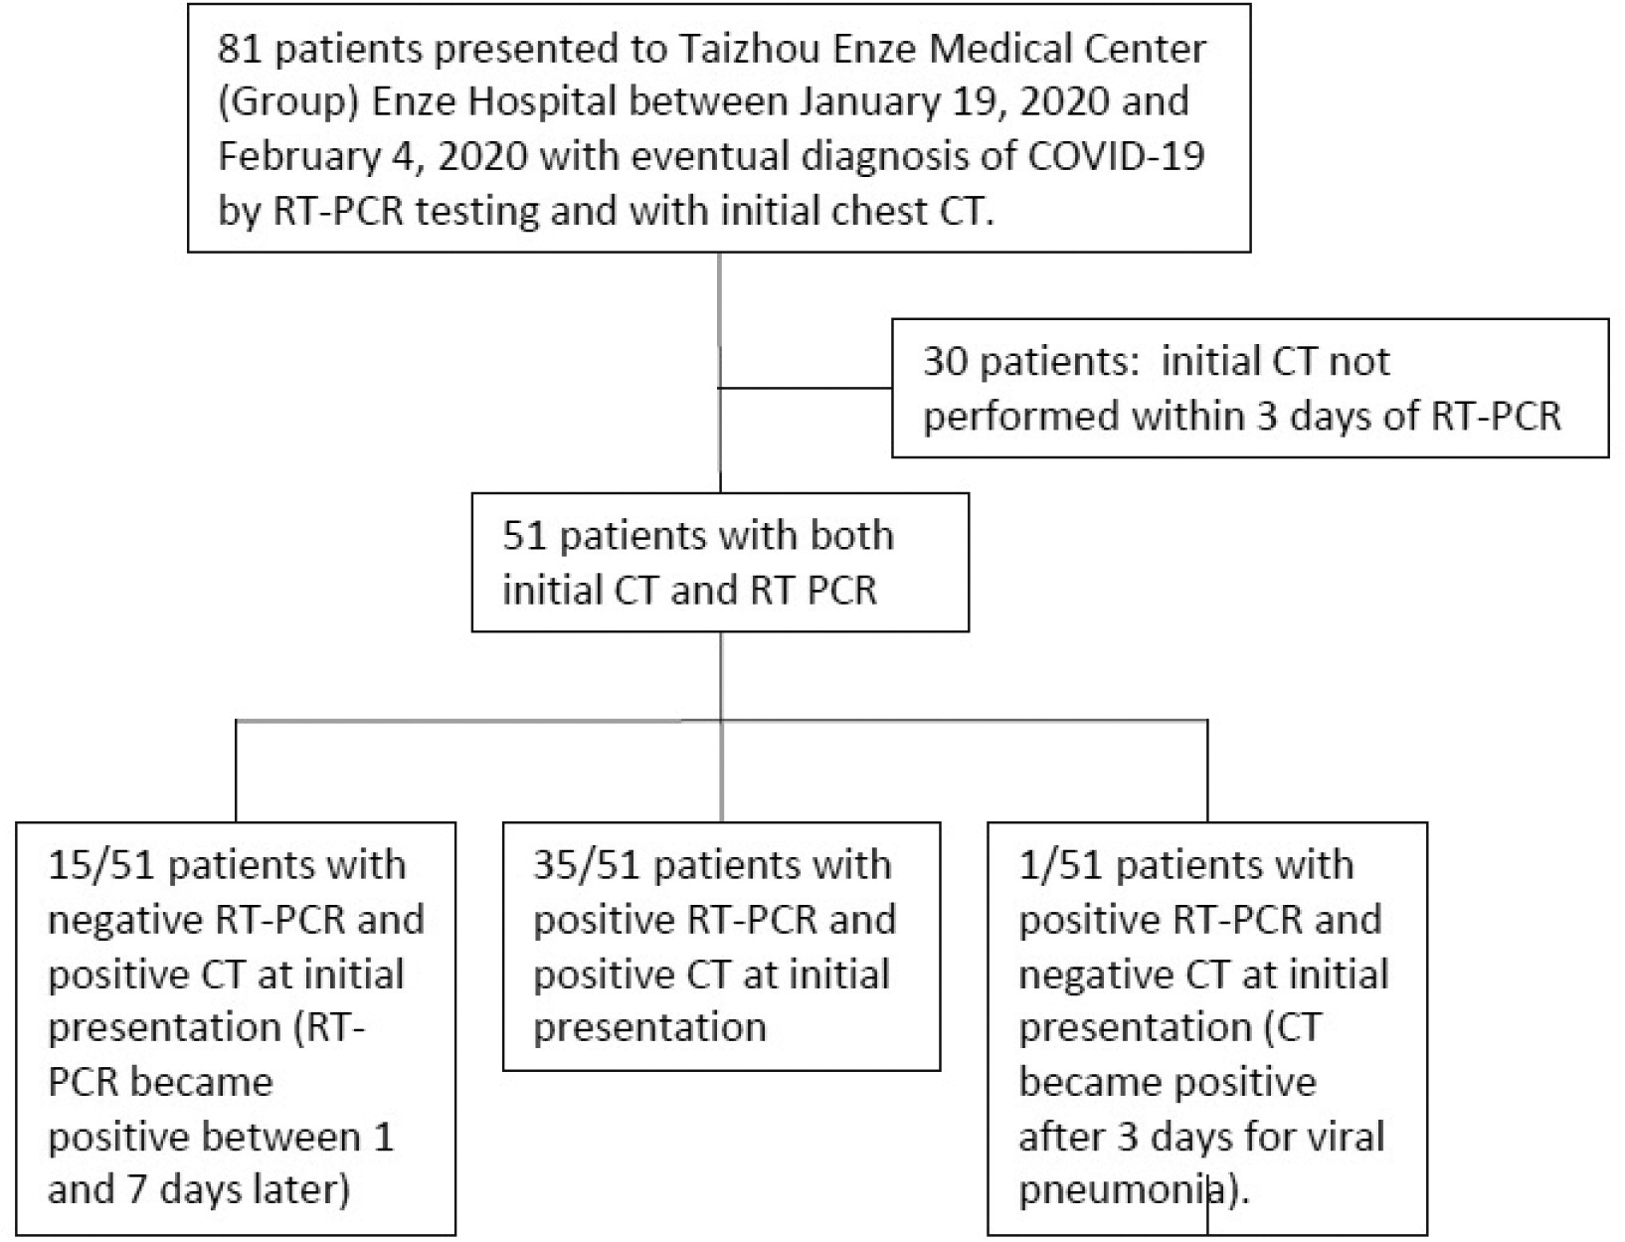
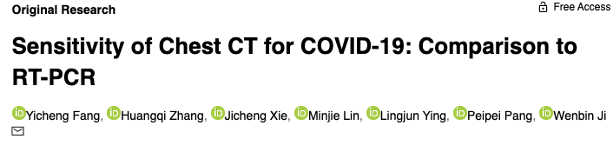
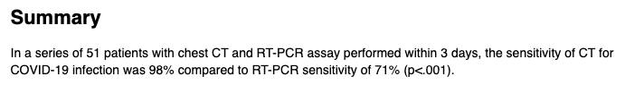
CT Scans better sensitivity than PCR?
https://doi.org/10.1148/radiol.2020200432
@UtahIMCMRS
Notes:
This started the idea that maybe because sensitive tests are for screening (more on this) and this is very sensitive in the study (98% by repeat RT-PCR testing), then we should use this for screening.
However, 2 problems: 1 is selection bias (only some people got CT scans, and we don’t know why). “One limitation of their study was selection bias. Patients in the cohort were selected to undergo CT on the basis of unknown clinical factors that may have distinguished them from similar patients who did not undergo CT. “
The other has to do with test characteristics
CT scan – details of Luke Oakden-Raynor’s presentation, and summary of the society recommendations - https://lukeoakdenrayner.wordpress.com/2020/03/23/ct-scanning-is-just-awful-for-diagnosing-covid-19/

Slide 5
Sensitivity vs positive predictive value
Depends on!
@UtahIMCMRS
Notes:
SENSITIVITY = Get people WITH the disease. In what proportion is the new test correct?
SPECIFICITY = Get people WITHOUT the disease. In what proportion is the new test correct?
PPV = Get people WITH a positive test. In what proportion is the test correct?
NPV = Get people WITHOUT a positive test. In what proportion is the test correct?
Sensitivity / Specificity = mostly measure how good the test is.
----
Review this only to highlight that these are best at the population level – likelihood ratio is better individual.
SPecificity rules in, SeNsitivity rules OUT – not exactly true. But we’ll return to that.
Sensitivity & Specificity = mostly measure how good the test is.
Of course this is not directly what we’re interested in, as two other key pieces of information before it’s used: how reliably the sample is collected, and is the virus in the fluid sampled during the disease.
PPV/NPV depends on a population prevalence, and gives us an average across the population = can give population level information, but difficult to apply to individual patients, who likely have characteristics that differ from the ‘average’ in a population.
https://calculator.testingwisely.com/playground/5/90/90/positive

Slide 6
Likelihood ratios patient-level metric
Ranji SR, Shojania KG, Trowbridge RL, Auerbach AD, Impact of CT on PE Diagnosis. J. Hosp. Med 2006;2;81-87. Jack Penner, MD - https://clinicalproblemsolving.com/2020/02/09/clinical-reasoning-corner-likelihood-ratios/
@UtahIMCMRS
Notes:
Note: this is all done in odds
Reason to use this (vs sens spec): it itemizes the test as just 1 data point out of many that you might consider.
Pretest -> if it’s your first test, this might be the population prevalence (if screening). If you’re using this as a test, it might be the post-test after, say, a negative PCR.
Note: whats the utility of bayes? Using a normative theory illustrates many of the pitfalls we might fall in to.

Slide 7


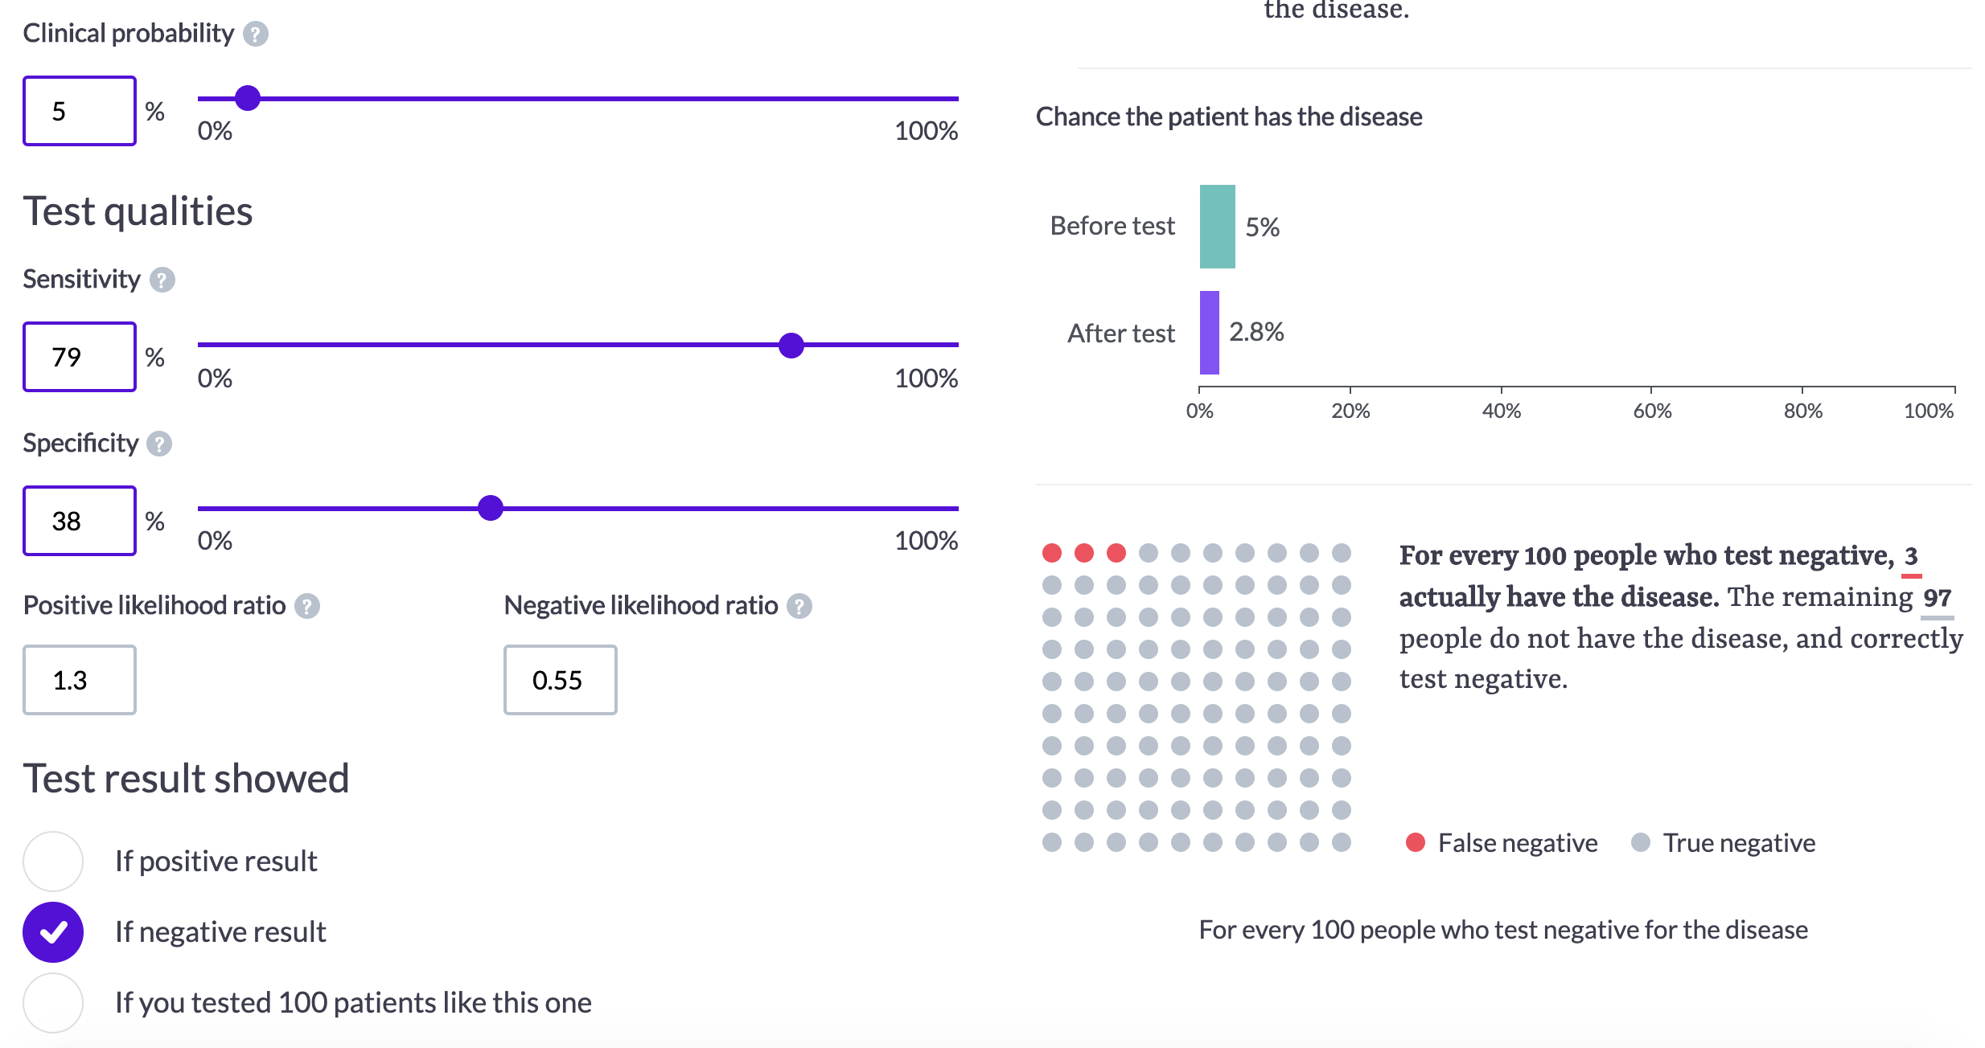
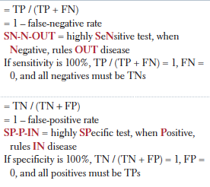
'SPIN’ and ‘SNOUT’ are dead
https://pubs.rsna.org/doi/10.1148/ryct.2020200152
Notes:
SPecificity rules in, SeNsitivity rules OUT – not exactly true.
Example:
Another source: pooled sensitivity of 94% and specificity 37%
Princess cruise ship who had COVID-19, CT findings were observed for 80% versus 46% of patients with and without symptoms, respectively [8]
These +LR and –LR are weak sauce. Your decision to test… maybe not all that influenced by CT findings?

Slide 8
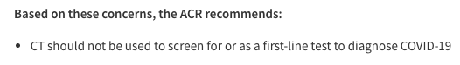
The Rule of 100: coin flips don’t help
PCR for COVID
X
X HIV PCR
More Informative Tests
X
Screening CT for COVID
https://emcrit.org/pulmcrit/mythbusting-sensitivity-specificity/
@UtahIMCMRS
Notes:
The rule of 100.
SPecificity rules in, SeNsitivity rules OUT – not exactly true.
Because if sensitivity + specificity sums to 100, no information is added by the test. (LR = 1).
Can see this a few ways:
Coin flips (weighted coin flips)
Math for LR formula
Visualized in chart:
Sensitivity & Specificity = mostly measure how good the test is. LR further away from 1 are ‘better tests’ = give you stronger information. LR green zone.= further from 1
CT FOR SCREENING, falls in to the yellow area – not very strong evidence.

Slide 9
Hypothesis-driven testing Not Screening
CXR w no Opacity
@UtahIMCMRS
Notes:
Imaging does have a role: in supporting or refuting specific hypotheses.
50 healthy F w 1 wk of SOB, my ddx includes PE, Bact Pna, or COVID. If a CXR is INCONSISTENT with some of these diagnoses, it makes it much less likely that is the diagnosis. (Eg no consolidation = I shouldn’t attribute hypoxia to that). More formally, this happens if the finding occurs more often in 1 diagnosis than the other (even though it may not be that helpful in all comers).

Slide 10
Hypothesis-driven testing Not Screening
CXR w peripheral
multifocal opacities
*3% normal w severe disease
@UtahIMCMRS
Notes:
Key:
Myalgia, fever, malaise, 1 week.
Imaging should be hypothesis testing
It’s usefulness depends on your differential diagnosis, and differential likelihood of the finding among the different considerations.
Differential presence - e.g. if the imaging finding is inconsistent, useful. If the findings are differentially present among ddx
Imaging is unlikely to help you at all for COVID vs other respiratory illness, but can be especially helpful for excluding PE, CHF, etc.

Slide 11
Summary: Give rads’ the history
Probability of Disease
????
CXR w peripheral
multifocal opacities
@UtahIMCMRS
Notes:
So, focus really needs to be on the findings specific to COVID compared to OTHER ITEMS ON THE DDx. SO GIVE THE HISTORY WHEN ORDERING – the test is not useful without it. They can help interpret the relative frequency of the findings.
As I demonstrated earlier, CT (and thus, by extension, CXR which certainly has worse characteristics) is NOT sufficient to provide useful information outside of the context of a hypothesis.

Slide 12
Radiographs
in COVID
@UtahIMCMRS

Slide 13
CXR lung fields, Dyspnea schema
Opacity
Consolidation = Infiltration = Air-Space Opacity
Interstitial
Atelectasis
Linear:
Kerley B-lines = thickening of septae from fluid
look for peripheral, perpendicular lines
Reticular: net-like linear opacities (e.g. IPF)
Nodule: LAD (hilar), Masses, Miliary
Linear or Wedge Shaped
Look for:
volume loss
Apex at hilum
Look for: Air bronchograms
Cause by: Pus, Aspiration, Water, Blood
Subtype:
Patchy = incomplete filling
Dense
Lobar
Multifocal
@UtahIMCMRS
Notes:
Opacity v lucency (Task 1: identify whiteness that shouldn’t be there)
Consolidation is more of a measure of the texture and hardening of the lungs.
Infiltrate = something in the airspaces (somewhat imprecise terms)

Slide 14
CXR Findings
Classic to COVID (though ?specific) | Might be COVID, might be something else | Not generally found with COVID
Infiltrates that are: Peripheral Patchy (‘Hazy’) Multifocal / Bilat. Lower zone | Lobar consolidation | Kerley B lines Pleural effusions Lymphadenopathy
@UtahIMCMRS
Notes:
Note that patchy opacity and multifocal opacity do NOT mean the same thing.
Example: yes/no

Slide 15
CXR practice #1
DDx = COVID vs other URI (not dyspneic)
@UtahIMCMRS
Notes:
DDx = COVID vs other URI (no dyspneic)
Atelectasis vs Air-space opacity
Volume loss = normal volume
Ipsilateral shift = no shift
Linear or Wedge shaped = lobar / segmental / multifocal
Apex is at hilum = no centered at hilum
Subtypes of atelectasis:
Resorptive = because of obstruction or mucus plug
Passive = PTX or Effusion
Compressive = nearby mass lesion
Scarring
Adhesive
Gravity-dependent atelectasis: Example Above
Case courtesy of Assoc Prof Frank Gaillard, Radiopaedia.org, rID: 7312

Slide 16
CXR practice #1
Atelectasis – two most common types we see
Gravity dependent atelectasis
Left Lower Lobe atelectasis
Case courtesy of Assoc Prof Frank Gaillard, Radiopaedia.org, rID: 7312
@UtahIMCMRS
Notes:
very commonly seen in the posterior lung bases on CT, particularly in elderly individuals.
Atelectasis vs Air-space opacity
Volume loss = normal volume
Ipsilateral shift = no shift
Linear or Wedge shaped = lobar / segmental / multifocal
Apex is at hilum = no centered at hilum
Subtypes of atelectasis:
Resorptive = because of obstruction or mucus plug
Passive = PTX or Effusion
Compressive = nearby mass lesion
Scarring
Adhesive
Gravity-dependent atelectasis: Example Above

Slide 17
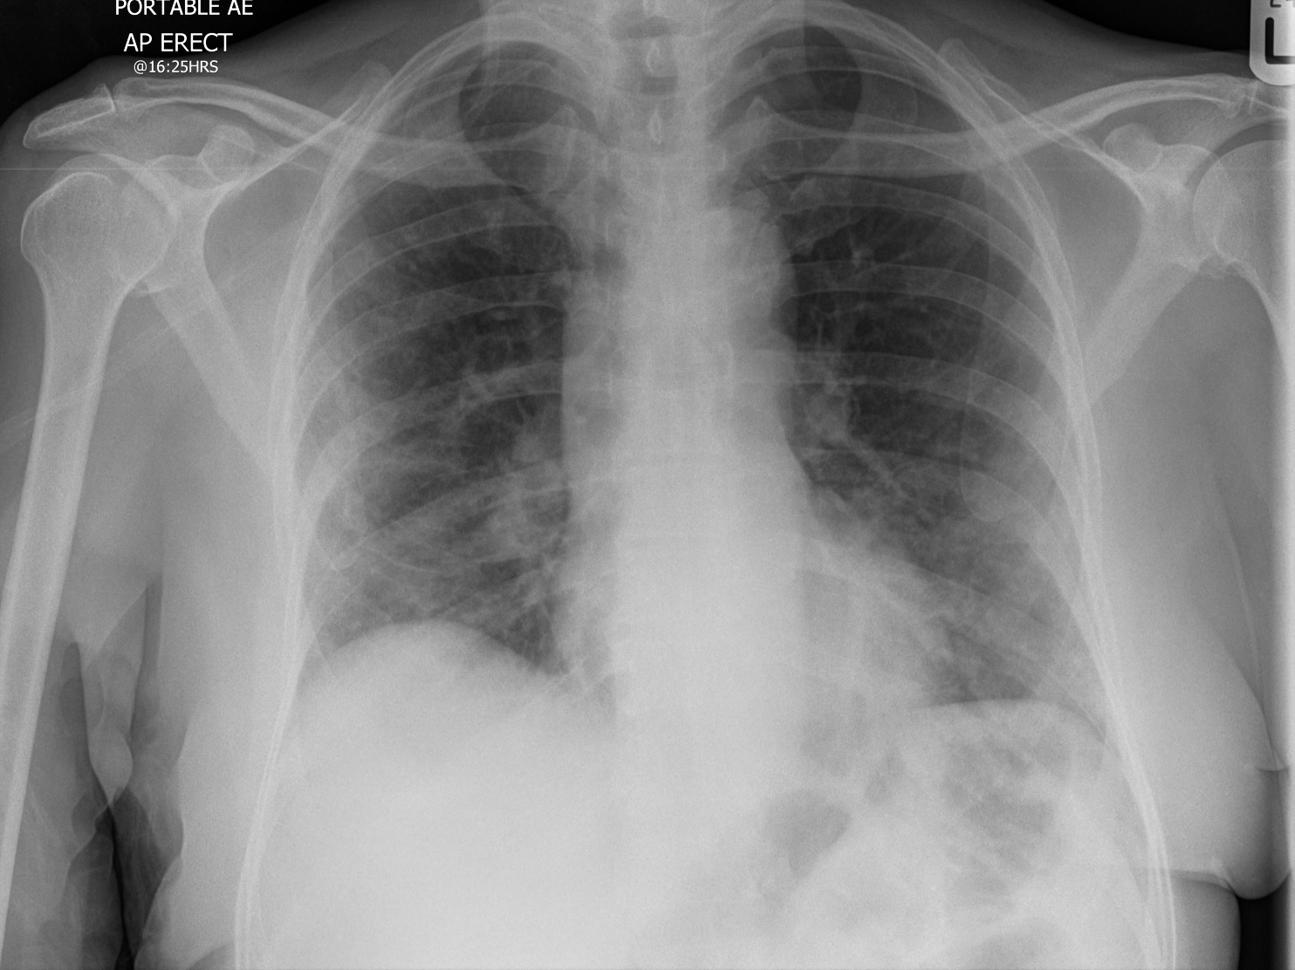
CXR practice #2
DDx = Pneumonia vs PE
Case courtesy of Dr. Mohammad Al-Tibi, Radiopaedia.org, rID: 75305
@UtahIMCMRS
Notes:
COVID?

Slide 18
CXR practice #2
Patchy (=‘hazy’) bilateral, peripheral, lower lobe air-space opacities.
Case courtesy of Dr. Mohammad Al-Tibi, Radiopaedia.org, rID: 75305
@UtahIMCMRS
Notes:
COVID?

Slide 19
CT Scans in COVID
@UtahIMCMRS

Slide 20
CT Schema
Ground Glass Opacities (GGOs)
What to look for: Can still make out lung architecture underneath it
What it is: Partially filled alveoli (=‘patchy’ opacity on radiograph)
GGO
Consolidation
@UtahIMCMRS
Notes:
What are GGOs? How is it different than consolidation?
Radio-pathological correlate: What is it, How do you identify it
GGO = still can see the architecture under, partially filled airspace
Consolidation = cannot see architecture under

Slide 21
CT Findings
Classic for COVID (though ?specific) | Might be COVID, might be something else | Not generally found with COVID
Subpleural, bilateral GGOs* Basal, rounded Bronchovascular thickening (in lesions) Intralobular lines = ’Crazy paving’ | GGOs in other distributions (perihilar, diffuse) Lobar/segmental consolidation (esp 9-13 days into illness | Effusions Lymphadenopathy Tree-in-bud Cavitation
https://radiopaedia.org/articles/covid-19-3 https://pubs.rsna.org/doi/10.1148/ryct.2020200152
@UtahIMCMRS
Notes:
3 categories: found in COVID, found in COVID and alternatives, not found in COVID
Peripheral, bilateral GGO’s with or without consolidation or intralobular lines (=crazy-paving)
(hilar would be less typical -> more suggestive of E-vali)
Multifocal Ggos. Reverse halo sign = organizing pneumonia in later disease.
However, a significant portion of cases have opacities without a clear or specific distribution (8). A predominant perihilar pattern was not reported => E-vali
CT pattern resembling organizing pneumonia, notably peripheral ground-glass opacities (GGO) and nodular or mass-like GGO that are often bilateral and multilobar (11). However, additional imaging findings have also been reported including linear, curvilinear or perilobular opacities, consolidation, and diffuse GGO, which can mimic several disease processes including other infections, inhalational exposures, and drug toxicities
Bronchial wall thickening, mucoid impactions, and nodules (“tree-in-bud” and centrilobular) seen commonly in infections, are not typically observed (8). Lymphadenopathy and pleural effusion have been rarely reported
A slight majority of patients had a negative CT during the first two days after symptom onset with GGO usually developing between day 0 and 4 after symptom onset and peaking at 6-13 days
A peripheral distribution of GGO was found to correctly distinguish COVID-19 from other viral causes 63-80% of the time. However, the authors did not include high numbers of influenza-A or any noninfectious causes such as drug reaction, which could degrade radiologists’ performance.
RSNA citation:

Slide 22
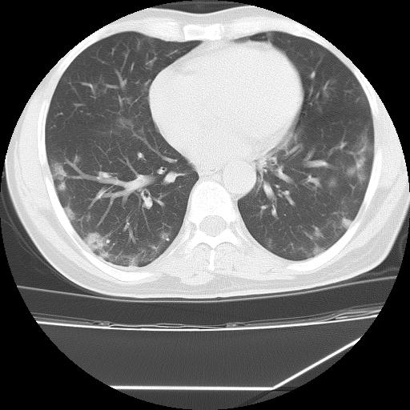
CT practice #1
DDx = COVID vs other URI (not dyspneic)
Case courtesy of Dr Bahman Rasuli, Radiopaedia.org, rID: 75768
@UtahIMCMRS

Slide 23
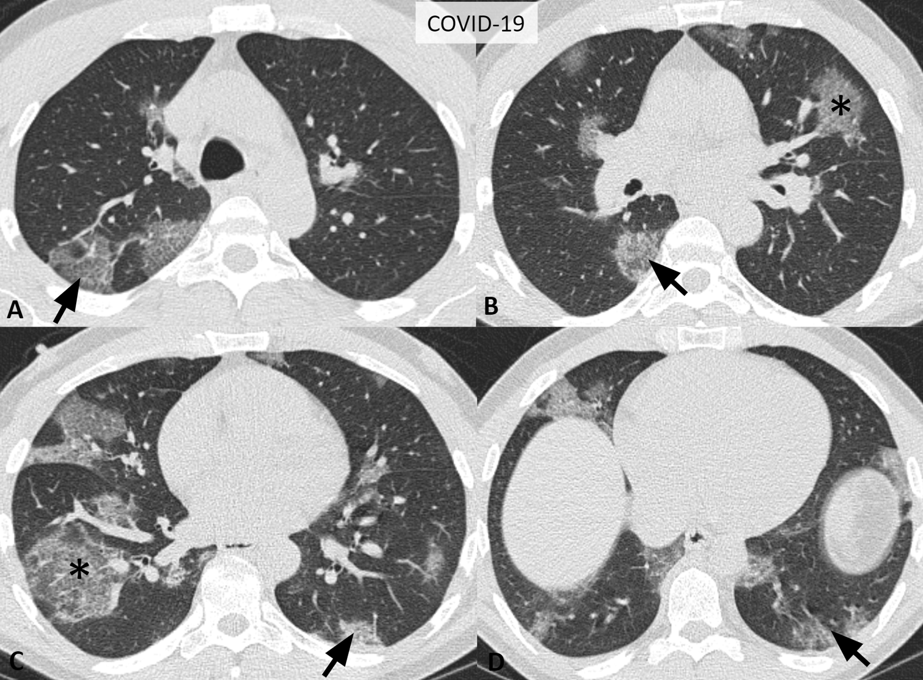
CT practice #1
Subplural GGOs
Case courtesy of Dr Bahman Rasuli, Radiopaedia.org, rID: 75768
@UtahIMCMRS

Slide 24
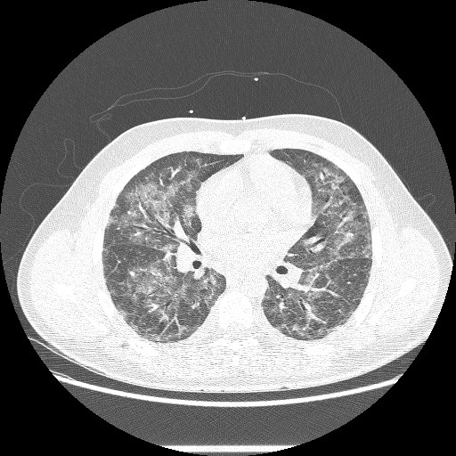
CT practice #2
Young, healthy, presents w 2 weeks SOB and GI symptoms
Case courtesy of Dr Michael P Hartung, Radiopaedia.org, rID: 71664
@UtahIMCMRS

Slide 25
CT practice #2
Young, healthy, presents w 2 weeks SOB and GI symptoms
And vapes!
Atypical distribution for COVID, but not impossible.
“Extensive symmetric bilateral groundglass and reticular opacities in a brochovascular distribution with subpleural sparing affecting all lobes”
Case courtesy of Dr Michael P Hartung, Radiopaedia.org, rID: 71664
@UtahIMCMRS

Slide 26
Summary points
Imaging is not useful for screening or as a primary diagnostic test (Rule of 100)
Imaging is useful to interrogate hypotheses about symptoms (Different probabilities)
GIVE THE HISTORY WHEN ORDERING IMAGING
CXR: Patchy, peripheral bilateral opacities
CT: Peripheral GGOs
@UtahIMCMRs
Notes:
The radiologists can help you

Slide 27


